Slide 1
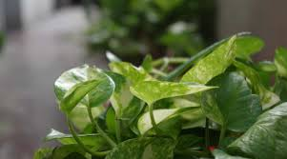
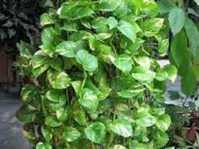
Money Plant
Near pre-primary gate –AIS campus Wakad

Slide 2
Common Name : Money Plant
Scientific Name : Epipremnum aureum
Family Name : Araceae
Habit : The money plant is a resilient, trailing vine that
thrives in arrange of light conditions and prefer to
be kept in well-draining soil with moderate watering.
Distribution : The money plant is native to the Solomon Islands
but has widely distributed across tropical and
subtropical regions.

Slide 3
Description
The money plant is a versatile, evergreen vine characterized by its heart-shaped, glossy leaves.
The leaves of the money plant are typically green but can vary with golden or white marbling.
It has a trailing or climbing growth habit and is valued for its low-maintenance care and ability to thrive in diverse indoor environments.
Well known for its adaptability and attractive foliage.

Slide 4
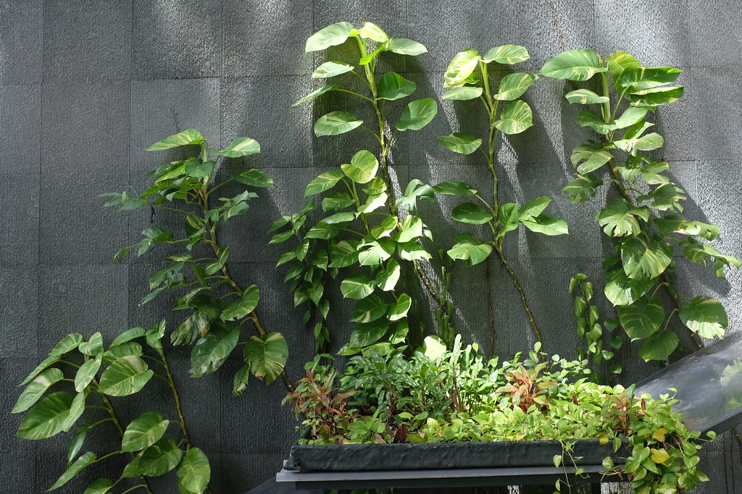
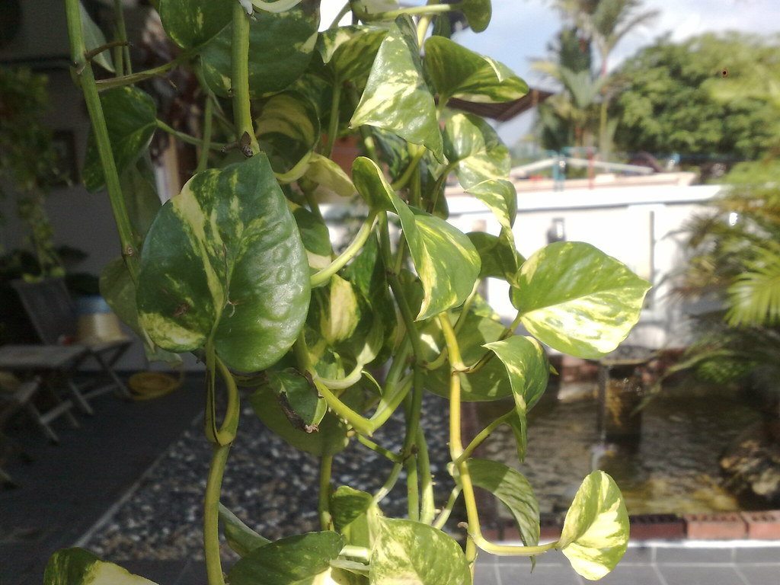
Uses

Slide 5
Indoor Decoration : It enhances the aesthetic appeal of spaces with its
lust, trailing vines and attractive foliage.
Air Purification : It helps improve indoor air quality by filtering out
pollutants like benzene and xylene.
Easy Care : Ideal for low-maintenance environments, making it suitable
for beginners and busy individuals.
Versatile Display : It can be grown in hanging baskets, as a climbing
plant on support, or allowed to trail from shelves
and containers.

